Slide 1

Chapter 2
Understanding Organizational
Style and Its Impact on
Information Systems
Systems Analysis and Design
Kendall and Kendall
Fifth Edition

Slide 2
Major Topics
Organizational environment
Nature of systems
Context-level data flow diagram
Entity-relationship diagram
Levels of management
Organizational culture

Slide 3
Organizations
Organizations are composed of interrelated and interdependent subsystems
System and subsystem boundaries and environments impact on information system analysis and design

Slide 4
Organizational Environment
Community environment
  Geographical
  Demographics (education, income)
Economic environment
  Market factors
  Competition
Political environment
  State and local government

Slide 5
Open and Closed Systems
Systems are described as either
  Open
    Free-flowing information
    Output from one system becomes input to another
  Closed with restricted access to information
    Limited by numerous rules
    Information on a need to know basis

Slide 6
Virtual Organizations
A virtual organization has parts of the organization in different physical locations
Computer networks and communications technology are used to work on projects

Slide 7
Virtual Organization Advantages
Advantages of a virtual organization are
  Reduced costs of physical facilities
  More rapid response to customer needs
  Flexibility for employees to care for children or aging parents

Slide 8
Enterprise Resource Planning
Enterprise Resource Planning (ERP) describes an integrated organizational information system
The software helps the flow of information between the functional areas within the organization

Slide 9
Context-Level Data Flow Diagram (DFD)
A context-level data flow diagram is an important tool for showing data used and information produced by a system
It provides an overview of the setting or environment the system exists within: which entities supply and receive data/information

Slide 10
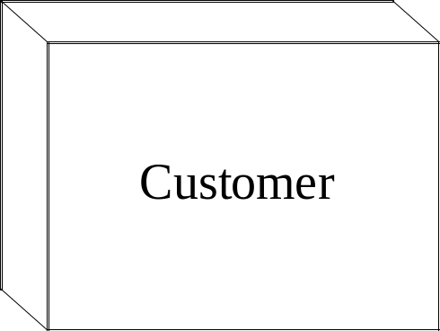
Context-Level DFD Symbols
Entity, a person, group, department, or system that supplies or receives information
It is labeled with a noun

Slide 11
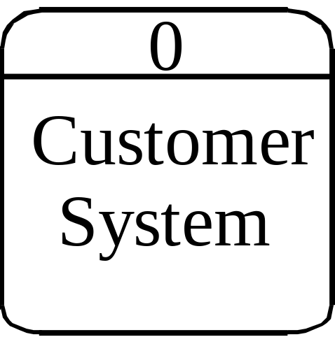
Context-Level DFD Symbols
Process, representing the entire system
It is given the number 0

Slide 12
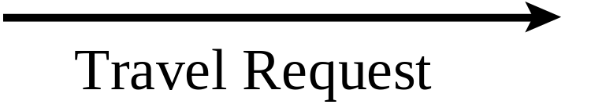
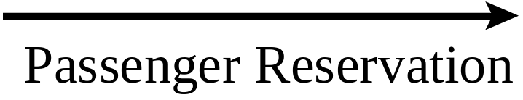
Context-Level DFD Symbols
Data flow, represented by an arrow
It shows information that passes to or from the process
Data flow is labeled with a noun

Slide 13
Entity-Relationship Diagrams (E-R Diagrams)
Entity-relationship diagrams help the analyst understand the organizational system and the data stored by the organization
Symbols are used to represent entities and relationships

Slide 14
Entities
There are three types of entities:
  Fundamental entity, describing a person, place, or thing
  Associative entity, linking entities
  Attributive entity, to describe attributes and repeating groups

Slide 15

Fundamental Entity
  Describes a person, place, or thing
  Symbol is a rectangle

Slide 16

Associative Entity
  Joins two entities
  Can only exist between two entities
  Symbol is a diamond inside a rectangle
  Also called a
    Gerund
    Junction
    Intersection
    Concatenated entity

Slide 17
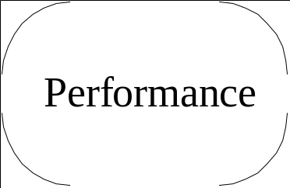
Attributive Entity
Describes attributes and repeating groups
Symbol is an oval in a rectangle

Slide 18
Relationships
Relationships show how the entities are connected
There are three types of relationships:
  One to one
  One to many
  Many to many
Relationship lines are labeled

Slide 19

Relationship Notation
One is indicated by a short vertical line
Many is indicated by a crows foot

Slide 20
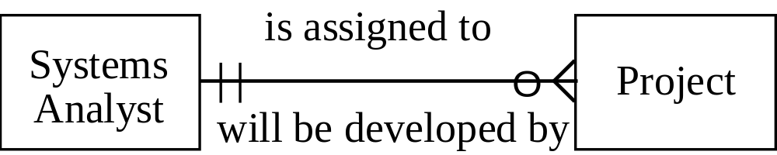
Entity Relationship Example

Slide 21
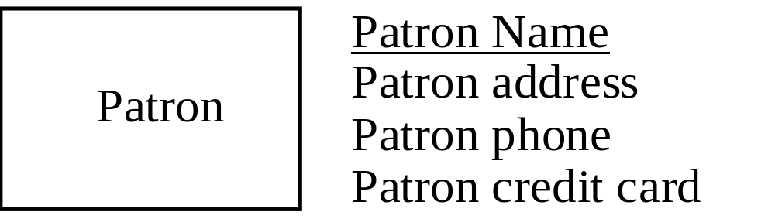
Attributes
Data attributes may be added to the diagram

Slide 22
Creating Entity-Relationship Diagrams
Steps used to create E-R diagrams
  List the entities in the organization
  Choose key entities to narrow the scope of the problem
  Identify what the primary entity should be
  Confirm the results of the above through data gathering

Slide 23
Managerial Control
The three levels of managerial control are
  Operations management
    Make decisions using predetermined rules
  Middle management
  Strategic management

Slide 24
Operations Management
Make decisions using predetermined rules that have predictable outcomes
Work is clear-cut
High degree of certainty in decision making
Oversee the operating details of the organization
Dependent on internal information

Slide 25
Middle Management
Make short-term planning and control decisions about resources and organizational objectives
Experience very little certainty in their decision making
Partly operational and partly strategic
Dependent on internal information, both historical and prediction oriented

Slide 26
Strategic Management
Look outward from the organization to the future
Make decisions that will guide middle and operations managers
Work in highly uncertain decision-making environment
Define the organization as a whole
Dependent on external information

Slide 27
Managerial Levels
  Each of the three levels of management have
    Different organization structure
    Leadership style
    Technological considerations
    Organization culture
    Human interaction
    All carry implications for the analysis and design of information systems

Slide 28
Organizational Culture
Organizations have cultures and subcultures
Learn from verbal and nonverbal symbolism

Slide 29
Verbal Symbolism
Using language to convey
  Myths
  Metaphors
  Visions
  Humor

Slide 30
Nonverbal Symbolism
Shared artifacts
  Trophies, etc.
Rites and rituals
  Promotions
  Birthdays, etc.
Clothing worn
Office placement and decorations

